Slide 1
Name :- Sairaj Rajput Enrollment:- 2104030100820 Div-F
DISASTER MANAGEMENT

Slide 2
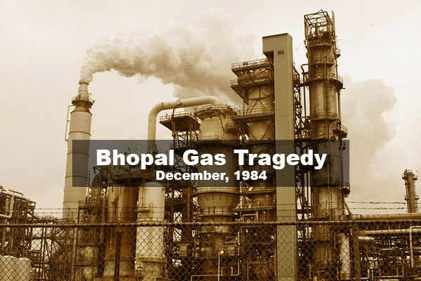
DISASTER MANAGEMENT
Bhopal disaster,
chemical leak in 1984 in the city of Bhopal, Madhya Pradesh state, India. At the time, it was called the worst industrial accident in history.

Slide 3
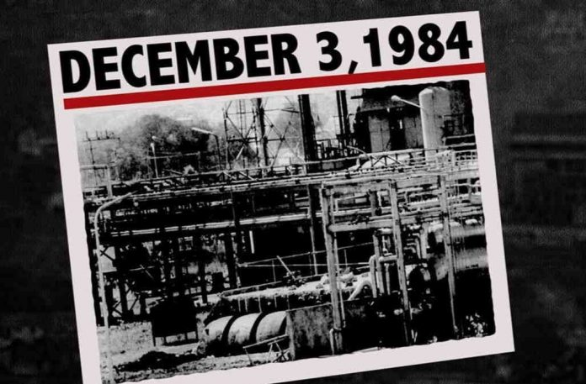
Background OF BHOPAL DISASTER
The Bhopal disaster, also referred to as the Bhopal gas tragedy, was a GAS LEAK incident on the night of 2–3 December 1984 at the UNION CARREBIAN INDIA LIMITED (UCIL) PESTICIED plant in BHOPAL, MADHYA PRADESH India.
It is considered among THE WORLD WORST INDUSTRIAL DISASTER .

Slide 4
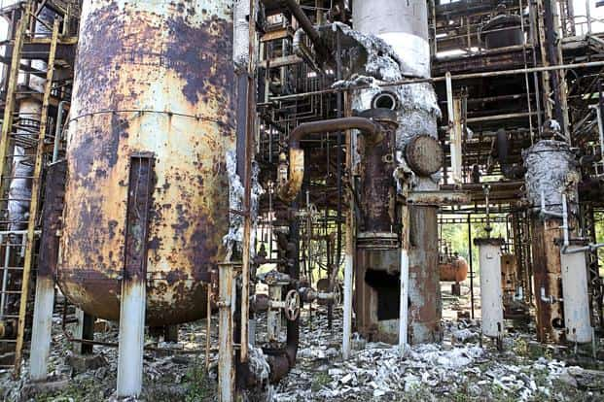
Earlier leaks
In 1976, two local trade unions complained of pollution within the plant. In 1981, a worker was accidentally splashed with phosgene as he was carrying out a maintenance job of the plant's pipes.
In a panic, he removed his gas mask and inhaled a large amount of toxic phosgene gas, leading to his death 72 hours later.

Slide 5
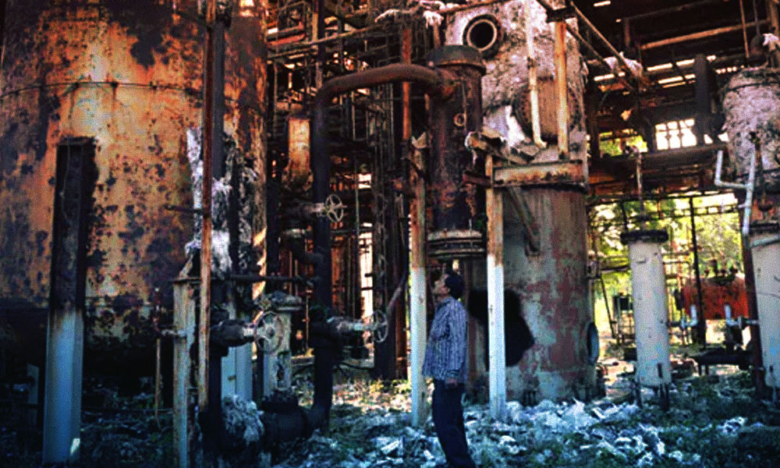
Leakage and its effects
Liquid MIC storage
A refrigeration system meant to cool tanks containing liquid MIC, shut down in January 1982, and whose freon had been removed in June 1984. Since the MIC storage system assumed refrigeration, its high temperature alarm, set to sound at 11 °C (52 °F) had long since been disconnected, and tank storage temperatures ranged between 15 °C (59 °F) and 40 °C (104 °F)
A flare tower, to burn the MIC gas as it escaped, which had had a connecting pipe removed for maintenance, and was improperly sized to neutralize a leak of the size produced by tank E610
A vent gas scrubber, which had been deactivated at the time and was in 'standby' mode, and similarly had insufficient caustic soda and power to safely stop a leak of the magnitude produced

Slide 6
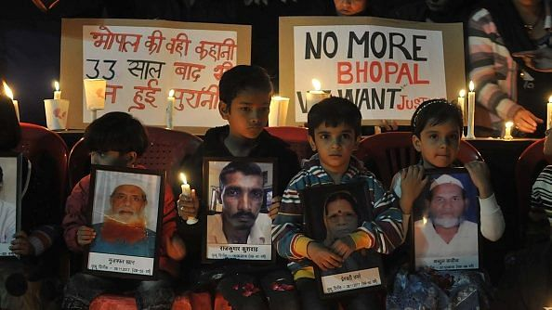
Long-term effects
Eyes: Chronic conjunctivitis, scars on cornea, corneal opacities, early cataracts
Respiratory tracts: Obstructive and/or restrictive disease, pulmonary fibrosis, aggravation of tuberculosis and chronic bronchitis
Neurological system: Impairment of memory, finer motor skills, numbness, etc.
Psychological problems: Post traumatic stress disorder (PTSD)
Children's health: Peri- and neonatal death rates increased. Failure to grow, intellectual impairment, etc.

Slide 7
Gas leak
By early December 1984, most of the plant's MIC related safety systems were malfunctioning and many valves and lines were in poor condition.
In addition, several vent gas scrubbers had been out of service as well as the steam boiler, intended to clean the pipes.
During the late evening hours of 2 December 1984, water was believed to have entered Tank E610 via a side pipe during attempts to unclog it. The tank still contained the 42 tons of MIC that had been there since late October.
The introduction of water into the tank resulted in a runaway exothermic reaction, which was accelerated by contaminants, high ambient temperatures and various other factors, such as the presence of iron from corroding non-stainless steel pipelines.
The pressure in tank E610, although initially nominal at 2 psi at 10:30 p.m., it had reached 10 psi by 11 p.m. Two different senior refinery employees assumed the reading was instrumentation malfunction.
By 11:30 p.m., workers in the MIC area were feeling the effects of minor exposure to MIC gas, and began to look for a leak. One was found by 11:45 p.m., and reported to the MIC supervisor on duty at the time. The decision was made to address the problem after a 12:15 a.m. tea break, and in the meantime, employees were instructed to continue looking for leaks.
The incident was discussed by MIC area employees during the break.

Slide 8
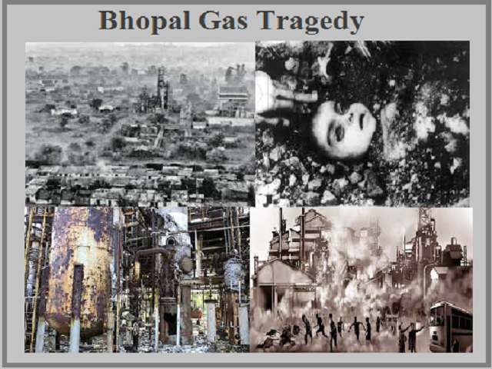
cloud Gas composition
Apart from MIC, based on laboratory simulation conditions, the gas cloud most likely also contained chloroform, dichloromethane, hydrogen chloride, methylamine, dimethylamine, trimethylamine and carbon dioxide, that was either present in the tank or was produced in the storage tank when MIC, chloroform and water reacted.
The gas cloud, composed mainly of materials denser than air, stayed close to the ground and spread in a southeasterly direction affecting the nearby communities. The chemical reactions may have produced a liquid or solid aerosol.
Laboratory investigations by CSIR and UCC scientists failed to demonstrate the presence of hydrogen cyanide.

Slide 9
THANK YOU

